Slide 2
Call to Worship
Psalm 99:1-5
The Lord reigns;
let the peoples tremble!
He sits enthroned
upon the cherubim;
let the earth quake!
The Lord is great in Zion;
he is exalted over all the peoples…

Slide 3
Let them praise your great
and awesome name!
Holy is he!
The King in his might loves justice.
You have established equity;
you have executed justice
and righteousness in Jacob.
Exalt the Lord our God;
worship at his footstool!
Holy is he!

Slide 4
To God Be The Glory
Text: Fanny J. Crosby • Music: William H. Doane
To God be the glory;
great things he has done!
So loved he the world
that he gave us his Son,

Slide 5
who yielded his life
our redemption to win,
and opened the life-gate,
that all may go in.

Slide 6
Praise the Lord, praise the Lord,
let the earth hear his voice!
Praise the Lord, praise the Lord,
let the people rejoice!

Slide 7
O come to the Father
through Jesus the Son,
and give him the glory;
great things he has done!

Slide 8
O perfect redemption,
the purchase of blood,
to every believer
the promise of God;

Slide 9
the vilest offender
who truly believes,
that moment from Jesus
a pardon receives.

Slide 10
Praise the Lord, praise the Lord,
let the earth hear his voice!
Praise the Lord, praise the Lord,
let the people rejoice!

Slide 11
O come to the Father
through Jesus the Son,
and give him the glory;
great things he has done!

Slide 12
Great things he has taught us,
great things he has done,
and great our rejoicing
through Jesus the Son;

Slide 13
but purer and higher
and greater will be
our wonder, our transport
when Jesus we see.

Slide 14
Praise the Lord, praise the Lord,
let the earth hear his voice!
Praise the Lord, praise the Lord,
let the people rejoice!

Slide 15
O come to the Father
through Jesus the Son,
and give him the glory;
great things he has done!
“To God Be The Glory” • Text: Fanny J. Crosby
Music: William H. Doane • Public Domain • CCLI License #11109756

Slide 16
Prayer of Invocation

Slide 17
Call to Confession of Sin
Micah 7:18
Who is a God like you,
pardoning iniquity
and passing over transgression
for the remnant of his inheritance?
He does not retain his anger forever,
because he delights in steadfast love.

Slide 18
Confession of Sin
Almighty God, our heavenly Father,
we have sinned against you and against our neighbor,
in thought and word and deed,
in the evil we have done
and in the good we have not done,
through our ignorance,
through weakness,
through our own deliberate fault…

Slide 19
We are truly sorry
and repent of all our sins.
For the sake of your Son,
Jesus Christ, who died for us,
forgive us all that is past;
and grant that we may serve you
in newness of life
to the glory of your name. Amen.

Slide 20
(Silent confession)

Slide 21
Assurance of Forgiveness
Micah 7:19
He will again have compassion on us;
he will tread our iniquities underfoot.
You will cast all our sins
into the depths of the sea.

Slide 22
May the peace of Christ be with you.
And also with you.

Slide 23
Offering
Malachi 3:10
“Bring the full tithe into the storehouse, that there may be food in my house. And thereby put me to the test, says the Lord of hosts, if I will not open the windows of heaven for you and pour down for you a blessing until there is no more need.”

Slide 24
The Doxology
Text: Thomas Ken (1674)
Music: “Old 100th” / Genevan Psalter / Louis Bourgeois (1551)
Praise God, from whom all blessings flow;
Praise him, all creatures here below;
Praise him above, ye heav’nly host;
Praise Father, Son, and Holy Ghost.
Amen.
Public Domain • CCLI License #11109756

Slide 25
Old Testament Reading
Ezekiel 34:1-16
…
The Word of the Lord.
Thanks be to God!

Slide 26
Prayers of the People
The Lord be with you.
And also with you.
Let us pray…

Slide 27
We extol you our God and King.
You exist in the mystery of the Trinity
as Father, Son, and Holy Spirit.

Slide 28
You live independent
of all that you have created.
You uphold and govern your creation
by your wise and holy providence.
Your wisdom is unsearchable,
and your thoughts are higher than ours.
Your justice is absolute
and perfectly fair.
There is none like you,
the Holy One of Israel.

Slide 29
Yet, as our great God and King,
you show mercy and compassion
to your creatures.

Slide 30
You dwell with the meek and lowly.
Your tender mercies
are over all of your works.
The broken spirit
and the contrite heart
you do not despise.
You live with us in grace
as our Father.

Slide 31
We come to you now
through our Lord Jesus Christ
to plead for your care for the Church.

Slide 32
Strengthen the churches
that proclaim your gospel.
Bless the churches and church plants
of the Pacific Northwest Presbytery,
and especially our church
here at Ascension.

Slide 33
We pray also for
your help and blessing for our city.

Slide 34
Grant your help and protection
to our Mayor and City Council.
Please bring financial prosperity
to our city.
Make Hillsboro a more just and
merciful and peaceful community.
Help your people to benefit our city
and to reflect your grace
in our callings.

Slide 35
Father, we thank you
for the mercy and kindness
you have shown to us in this country.

Slide 36
Give us
wisdom in the use of our wealth.
We ask for
purity in the use of our freedoms.
We ask that
our leaders might serve with humility,
compassion and justice.

Slide 37
Our Savior,
we appeal to your great compassion
for help to those among us
who are suffering.

Slide 38
Heal those who are sick.
Encourage those who are
discouraged and depressed.
Provide for those
who are struggling financially.
Comfort those who are grieving.
Give hope to those who are suffering
in guilt and doubt.

Slide 39
Our great God,
we ask you to hear us
and to work in us
that which is pleasing to you,
as we pray in the words
our Savior taught us:

Slide 40
Our Father, who art in heaven,
hallowed be Thy name.
Thy kingdom come, Thy will be done
on earth as it is in heaven.
Give us this day our daily bread,
And forgive us our debts
as we forgive our debtors.
And lead us not into temptation
but deliver us from evil.
For Thine is the kingdom and the power
and the glory forever. Amen.

Slide 41
The Valley May Be Dark
Text & Music: Wesley Randolph Eader
Adam’s shadow,
it was casted.
How it covered
all the land.

Slide 42
Out from Eden
it descended,
now to land on
our guilty hands.

Slide 43
The Laws of Moses,
they were roaring
in the face
of sinful man.

Slide 44
The sacrifices
they would offer
could never meet
its great demands.

Slide 45
And that valley
may be dark
(may be dark)
over all the earth extended,

Slide 46
but the love
(but the love)
of God is brighter
(of God is brighter)
and its path cannot be bended.

Slide 47
Yes it hits
(yes it hits)
the sinner’s heart
(the sinner’s heart),
turns their sorrow into laughter.

Slide 48
And with joy
(and with joy)
they will dance
(they will dance)
up the mount of the redeemed.

Slide 49
Prophets came
and prophets went,
and their message
was the same.

Slide 50
A Messiah
would soon be coming
for the wandering
souls to save.

Slide 51
John would baptize
with streams of Jordan,
Christ would baptize
with streams of life.

Slide 52
And that valley
may be dark
(may be dark)
over all the earth extended,

Slide 53
but the love
(but the love)
of God is brighter
(of God is brighter)
and its path cannot be bended.

Slide 54
Yes it hits
(yes it hits)
the sinner’s heart
(the sinner’s heart),
turns their sorrow into laughter.

Slide 55
And with joy
(and with joy)
they will dance
(they will dance)
up the mount of the redeemed.
“The Valley May Be Dark”
Text & Music: Wesley Randolph Eader • © 2014 Door of Hope • CCLI License #11109756

Slide 56
Sing A Psalm Of Joy
Text: Psalm 81 (1912 Psalter) • Music: Matthew H. Curl
Sing a psalm of joy!
Shout in celebration!
Let the tambourine
and the trumpet bring
praises to our King,
for his great salvation.

Slide 57
Sing a psalm!
Sing a psalm of joy!
Sing a psalm!
Shout in celebration!

Slide 58
Sound the festal horn,
your thanksgiving voicing.
Praise the Lord your God,
as he did command,
when from Egypt’s land
you came forth rejoicing.

Slide 59
Sing a psalm!
Sing a psalm of joy!
Sing a psalm!
Shout in celebration!

Slide 60
O my people hear;
when I call you, listen.
Choose no foreign god,
listen to my plea,
have no god but me;
come and be forgiven.

Slide 61
Sing a psalm!
Sing a psalm of joy!
Sing a psalm!
Shout in celebration!

Slide 62
With the finest wheat,
I your Lord, would feed you.
Honey from the rock,
I would gladly give,
that you all might live;
hear me O my people.

Slide 63
Sing a psalm!
Sing a psalm of joy!
Sing a psalm!
Shout in celebration!
“Sing A Psalm Of Joy” • Text: Psalm 81 (1912 Psalter)
Music: Matthew H. Curl • Public Domain • CCLI License #11109756

Slide 64
Gospel Reading
Luke 15
…
The Gospel of Jesus Christ.
Praise be to you, O Christ!

Slide 65
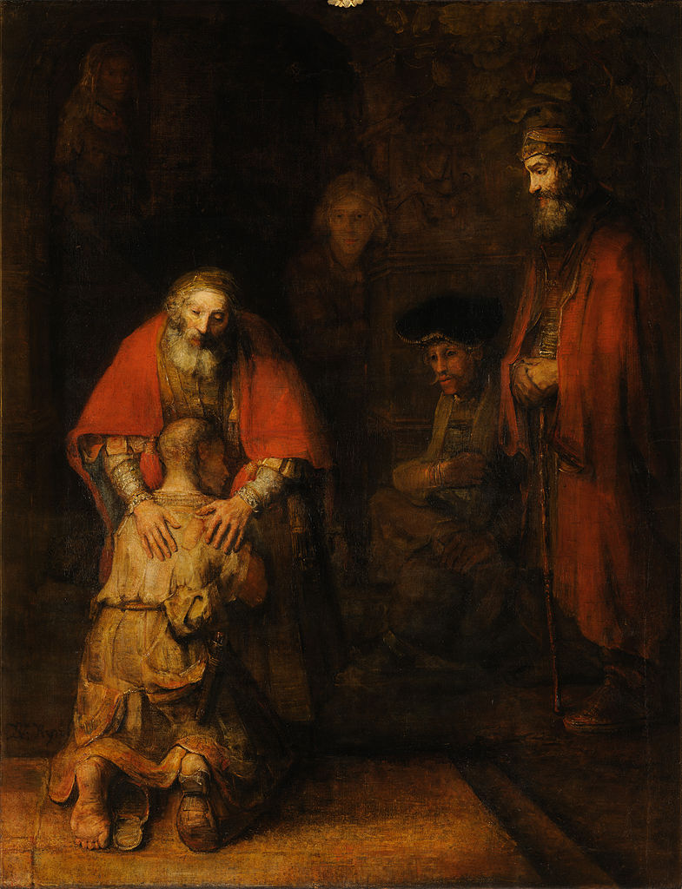

Slide 66
Confession of Faith
The Heidelberg Catechism, Question 60
How are you right with God?
Only by true faith in Jesus Christ. Even though my conscience accuses me of having grievously sinned against all God’s commandments and of never having kept any of them…

Slide 67
and even though I am still inclined toward all evil, nevertheless, without my deserving it at all, out of sheer grace, God grants and credits to me the perfect satisfaction, righteousness, and holiness of Christ…

Slide 68
as if I had never sinned or been a sinner, as if I had been as perfectly obedient as Christ was obedient for me. All I need to do is to accept this gift with a believing heart. Amen.

Slide 69
Passing of the Peace
Colossians 3:15
Let the peace of Christ rule in your hearts,
to which indeed you were called in one body.
And be thankful.
(Greet one another with the words,
“The peace of Christ be with you.”)

Slide 70
Institution of the Lord’s Table

Slide 71
Mysterium Fidei
(The Mystery of Faith)
Let us proclaim the mystery of faith.
Christ has died.
Christ is risen.
Christ will come again!
Christ our Passover is sacrificed for us.
Therefore let us keep the feast.
The gifts of God for the people of God.

Slide 72
There Is A Redeemer
Text & Music: Melody Green
There is a Redeemer, Jesus, God’s own Son, precious Lamb of God, Messiah, Holy One.

Slide 73
Jesus my Redeemer, name above all names, precious Lamb of God, Messiah, O, for sinners slain.

Slide 74
Thank you, O my Father, for giving us your Son, and leaving your Spirit
’til the work on earth is done.

Slide 75
When I stand in glory, I will see his face, and there I’ll serve my king forever in that holy place.

Slide 76
Thank you, O my Father, for giving us your Son, and leaving your Spirit
’til the work on earth is done.

Slide 77
There is a Redeemer, Jesus, God’s own Son, precious Lamb of God, Messiah, Holy One.

Slide 78
Thank you, O my Father, for giving us your Son, and leaving your Spirit
’til the work on earth is done.

Slide 79
and leaving your Spirit
’til the work on earth is done.
“There Is A Redeemer” • Text & Music: Melody Green
© 1982 Birdwing Music • CCLI License #11109756

Slide 80
What Wondrous Love Is This
Text: American Folk Hymn • Music: Southern Harmony
What wondrous love is this,
O my soul, O my soul!
What wondrous love is this,
O my soul!

Slide 81
What wondrous love is this
that caused the Lord of bliss
to bear the dreadful curse
for my soul, for my soul,
to bear the dreadful curse
for my soul!

Slide 82
When I was sinking down,
sinking down, sinking down;
when I was sinking down,
sinking down.

Slide 83
When I was sinking down
beneath God’s righteous frown,
Christ laid aside his crown
for my soul, for my soul;
Christ laid aside his crown
for my soul!

Slide 84
To God and to the Lamb
I will sing, I will sing;
to God and to the Lamb
I will sing.

Slide 85
To God and to the Lamb
who is the great “I am,”
while millions join the theme
I will sing, I will sing;
while millions join the theme
I will sing!

Slide 86
And when from death I’m free,
I’ll sing on, I’ll sing on;
and when from death I’m free,
I’ll sing on.

Slide 87
And when from death I’m free,
I’ll sing and joyful be,
and through eternity,
I’ll sing on, I’ll sing on;
and through eternity,
I’ll sing on.
“What Wondrous Love Is This” • Text: American Folk Hymn
Music: Southern Harmony • Public Domain • CCLI License #11109756

Slide 88
Benediction
2 Corinthians 13:14

